Slide 1
Case Study 1: Beers and Brews
David Wei, Neil Benson

Slide 2
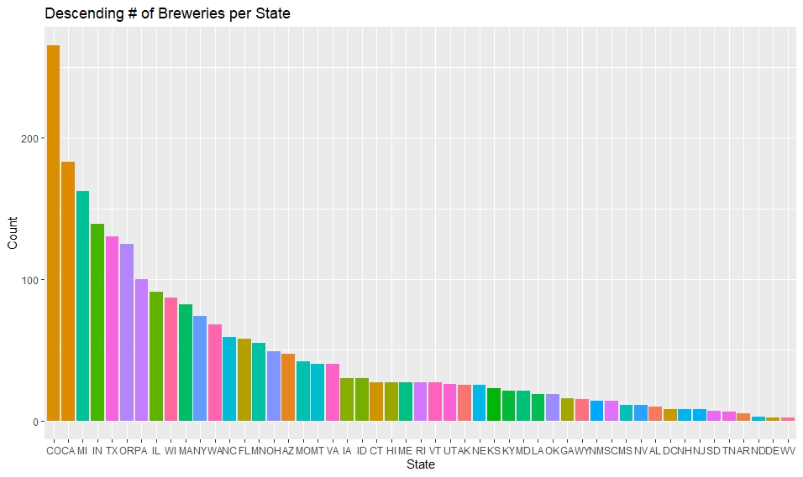
Brewery Statistics per State

Slide 3
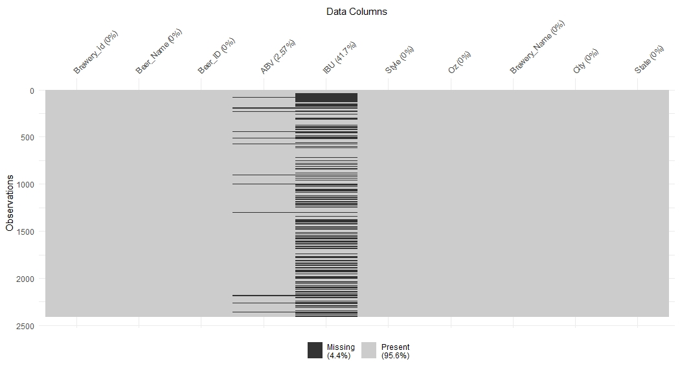
Cleaning the Data

Slide 4
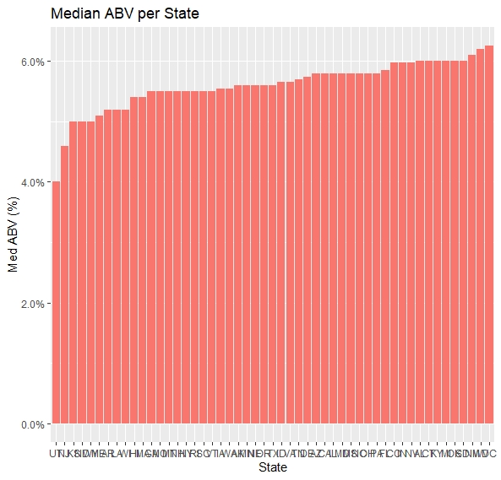
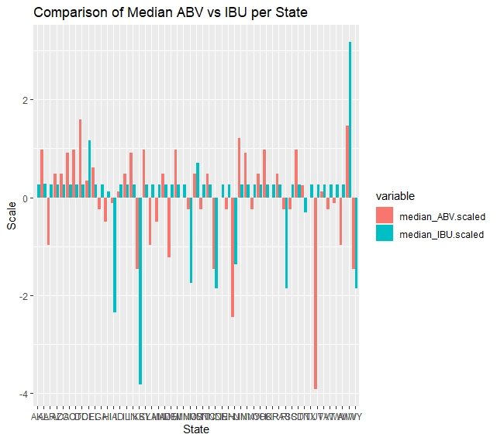
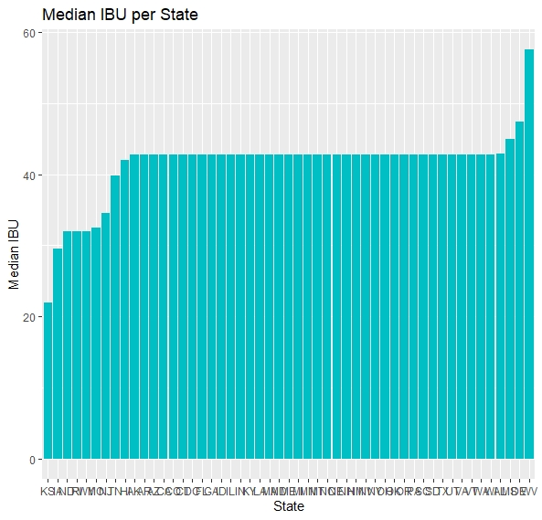
Median ABV and IBU per State

Slide 5
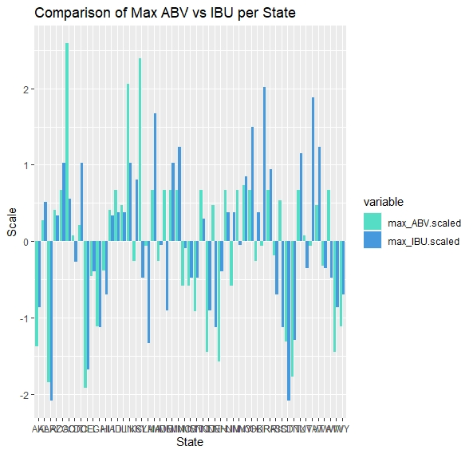
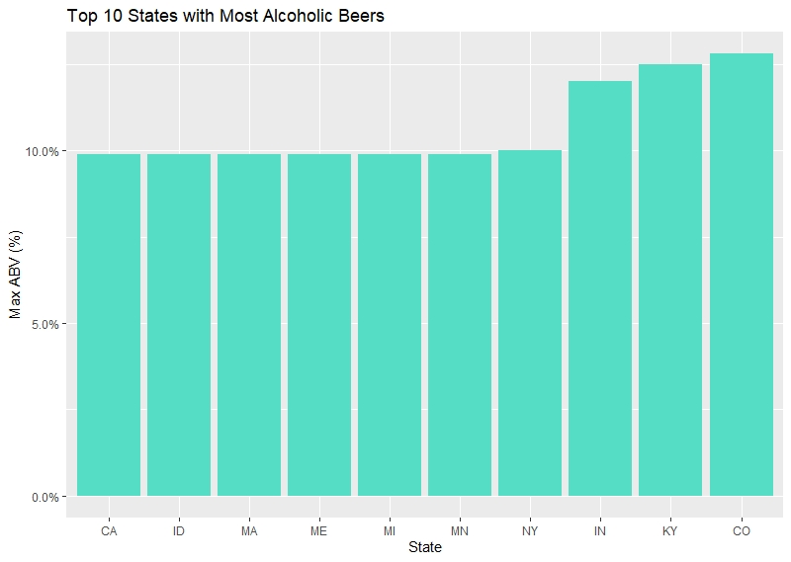
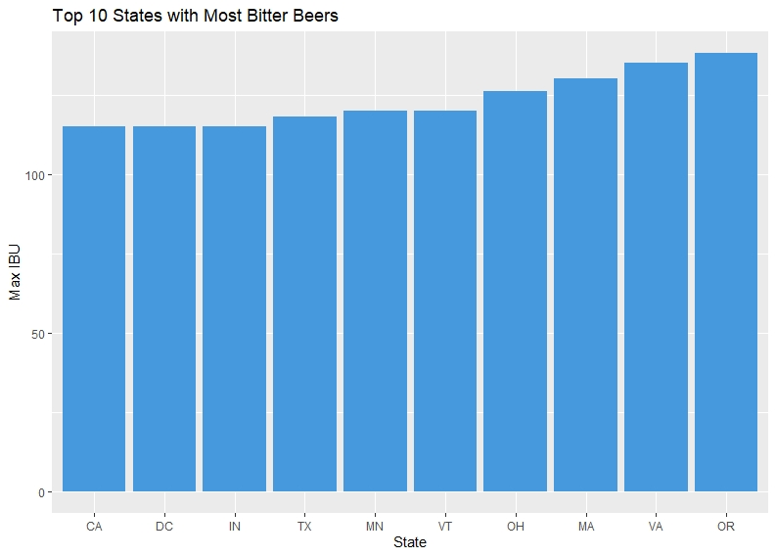
States with highest ABV and IBU

Slide 6
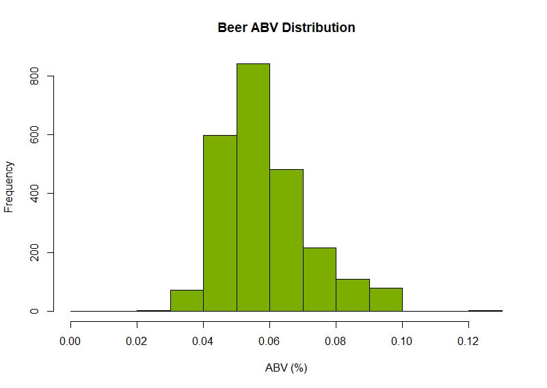
Analysis of ABV

Slide 7
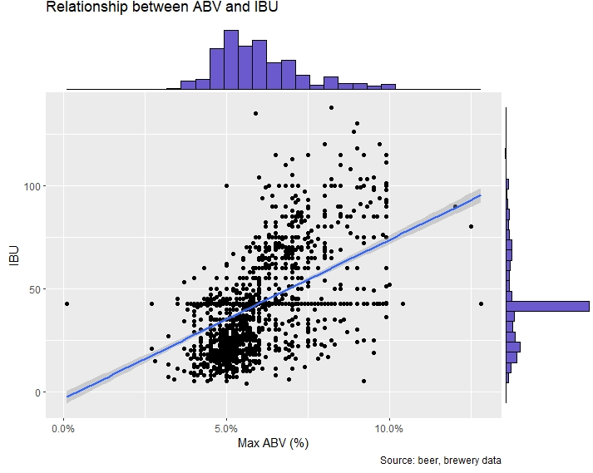
Relationship between IBU and ABV?
IBU
Factors: Bittering compounds
ABV
Factors: Sugar levels during fermentation
Analysis: Weak correlation between IBU and ABV though absence of high IBU beers with low ABV content.
Future QOI: ABV vs Sugar?
Corr = 0.520

Slide 8
Comparing IPAs vs Ales (knn)

Slide 9
EDA Inference

